Slide 1

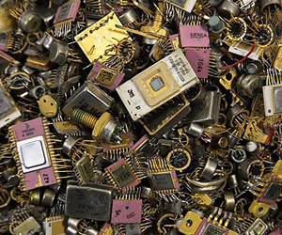
01-Computing Abstractions
Photo by: Steven Gerner, https://www.flickr.com/photos/
sgerner/16477700444/in/photostream/
COMP 256 – Dickinson College
Prof. Braught
Spring 2023
Image from: https://plada.com.ua/
g27814829-pererabotka-loma-othodov

Slide 2
“In the development of the understanding of complex phenomena, the most powerful tool available to the human intellect is abstraction.” C. Antony “Tony” R. Hoare Notes on Data Structuring (1972)
Notes:
Pretty heady stuff.
But true… without abstraction nothing we do as computer scientists would be possible.
Hoare
- Computer Science Pioneer
- Turing award winner for “For his fundamental contributions to the definition and design of programming languages.”
- Nobel Prize of Computer Science
- Invented QuickSort
- Invented null reference – and it’s said he regretted it ever since.

Slide 3
Course Mechanics

Slide 4
COMP256 in the Big Picture
Notes:
Here is the full COMP Major laid out.
Comp 256 is the foundation for the Abstractions and Systems area
We’ll learn more about what we mean by abstractions as we go along.
It is the prerequisite for any of the Abstraction Implementation courses
- Must take one for the major.
- Computer Networks
- Operating Systems
- Possibly others (e.g. Computer Architecture)

Slide 5
Course Materials
My Website:
www.dickinson.edu/~braught
Office hours and link to course website.
Course Website:
https://dickinson-comp256.github.io/website/
Moodle:
Homework and Lab Submission
Returned work
COMP256-S23 Team
Announcements from me
Q&A on Material, Homework, Labs
Syllabus
Class schedule
Homework Activities (Every day)
Lab Activities (~1 per/week)
Exams (2 mid-term, 1 final - cumulative)
Notes:
Read the Syllabus.
All of the course policies
- Grading
- Assignment Resubmissions
- Etc. It is stuff you will want to know.
Syllabus Quiz
- on Moodle
- Due before next class.
I will take questions on the Syllabus and Course Policies at the start of the next class.

Slide 6
“The essence of abstractions is preserving information that is relevant in a given context and forgetting information that is irrelevant in that context.” John V. Guttag Introduction to Computation and Programming Using Python (Spring 2013 ed.)
* Emphasis added.
Notes:
Note this is somewhat the opposite of the common use of “Abstract”
- Abstract ideas / abstract art
- Typically perceived as harder to understand
- In computing, we use abstraction to make things easier to understand and use.
- Abstractions:
- let us focus on information (i.e. details) that we care about for what we are doing.
- i.e. are relevant for the task at hand.
- while ignoring information (i.e. details) that we don’t dare about for what we are doing.
- i.e. are irrelevant for the task at hand.
Turns out you do this all of the time without even thinking about it.
But in reality, it turns out that much of what you do everyday relies on abstraction.
- In fact, much of what you do on a daily basis would be impossible without abstractions.

Slide 7

Some Computing Abstractions that You’ve (likely) Seen
Random Number Generation (Python)
Dictionary (i.e. Map) Object (Python)
Try it: https://repl.it/@144862/Python-Random-Numbers#main.py
What details do we pay attention to and what details do we ignore when we use these abstractions?
Try it: https://repl.it/@AbhijitSingh1/Python-Dictionaries
Notes:
Let’s start with some programming examples, since this is a CS course.
Here the abstractions are:
- The random.randomint method
- Note: randint is inclusive [1…10]
- Similar to Math.Random in Java if you haven’t used python.
- The python dictionary
- Similar to a HashMap in Java if you haven’t used python.
- Maps a key to a value
- Key: Name
- Value: Phone number
Then pose the question…
- Discuss with a neighbor and report out.

Slide 8
Abstractions in the Physical World
How can we think of a television remote control as an abstraction?
What info is relevant?
What info is irrelevant?
What is another physical world abstraction that you can think of?
Image from: https://dribbble.com/shots/2281082-Cable-
Lovers-Icon#shot-description
Notes:
Let’s think about a common abstraction that many of you use often.
- The television remote control.
Introduce yourself to a neighbor or two.
Discuss these questions:
- Be sure to identify
- the relevant (observed and useful) information.
- the irrelevant (hidden) information.
Then report out.

Slide 9
Abstraction Hierarchies
Abstraction hierarchies build bridges across chasms of complexity
Photo by: Steven Gerner, https://www.flickr.com/photos/sgerner/16477700444/in/photostream/
Used under a Creative Commons by-sa 2.0 license: https://creativecommons.org/licenses/by-sa/2.0/
Notes:
Sometimes the gap is so large its hard to see how to use the fundamentals to build an abstraction.
- e.g. how do a bunch of transistors execute a python program?
In practice what happens is we build hierarchies of abstractions.
- the primitive ideas are used to build higher level ideas (abstractions)
- letting us forget about the lower level details and build higher level abstractions
- and so on.
Here we can see they built a low bridge
- then built on top of that
- then built on top of that
- each layer making the next layer possible without worrying about the lower levels.
In mathematics:
- we start thinking about the area under a curve as adding up the area of bunch of rectangles
- then we introduce the integral which is an abstraction for that idea
- we can then work with integrals without thinking about the rectangles
- we can then produce theorems that involve integrals and forget about the integrals they contain.
- And use those to prove more theorems while forgetting about the lower level details
Let’s look at the idea of abstraction hierarchies in some other examples.

Slide 10
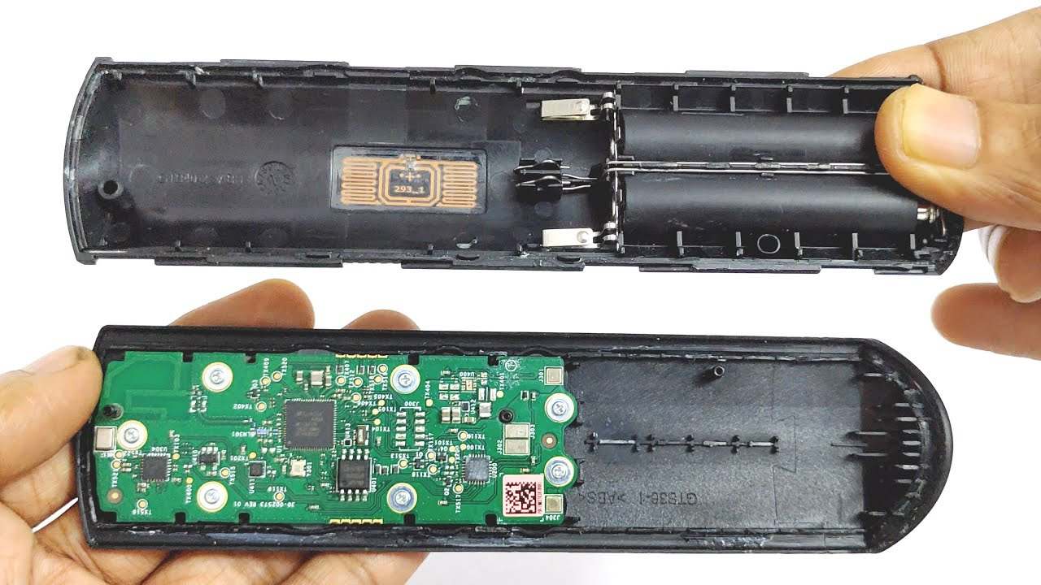
Abstraction Hierarchies: TV Remote
Image from: https://www.youtube.com/watch?app=desktop&v=6OinNv8L1vk
Notes:
Remote control –
- It would be Impossible to understand exactly how it works by thinking about transistors.
- So there are levels of abstraction
- Or an Abstraction Hierarchy
- if you open the remote you’ll see electronic chips
- an electronic engineer could build the remote by understanding what the chips do
- but those chips contain electronic circuits inside them
- Someone had to understand the details of those circuits
- but once they did, the electronic engineer could ignore them.
- those circuits would be made from transistors
- The person that designed the circuits would understand how to use the transistors
- but not necessarily how they are made and how they function on a molecular level.
The point is, that an abstraction we are using may be built on top of many lower layers of abstraction
- That is, we will often have an abstraction a hierarchy
- You can then work at a level of abstraction that is appropriate to your task.
- You can then focus on the details that are relevant to what you are doing, and ignore the others.
- e.g. think about the chips and what they do, but not how they do it.
- e.g. think about what the buttons on the remote do, but not how they do it.

Slide 11
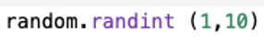
Abstraction Hierarchies: Python randint
Inside
randint()
Inside
randrange()
Code from: https://github.com/python/cpython/blob/master/Lib/random.py
Notes:
We do the same thing in programming all of the time.
Randint –
- we see it at one level
- Need to know:
- the function name
- the parameters to pass and what they do.
- what the function returns.
- Do not need to know
- how it generates the return value.
If we dig into the randint function we’ll see it has a hierarchy of abstractions.
- inside it actually calls another function
- which calls another function
- which calls another function
- and so on…
We don’t need to understand what these functions do to use randint…
The point here is that it turns out that randint is complicated…
- so it is built on top of other abstractions (functions)
- Each layer of abstraction hides more details making it easier and easier to use
In a little more detail:
- we can think of randInt as being inclusive from 1 to 10.
- we don’t have to worry or even know that internally, it isn’t…
- thus the b+1 in the call to randrange.
- this information is hidden from us.
- Similarly at a high level, we don’t need to know that a few more layers down our random number is based on getting some number of random bits (0’s and 1’s).

Slide 12
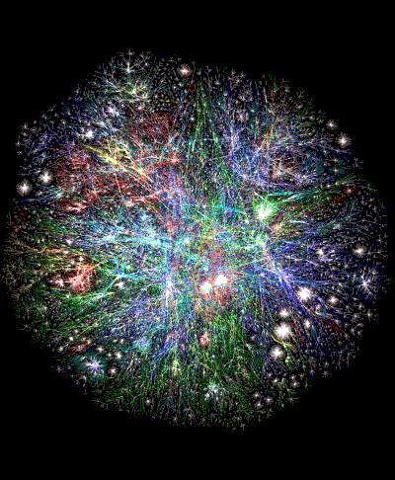
Abstraction Hierarchies in this Class
Hardware Abstractions
Data Abstractions
Machine Abstractions
Image from: https://plada.com.ua/
g27814829-pererabotka-loma-othodov
Image from: https://mse238blog.stanford.edu
/2017/08/jaydchen/five-thoughts-on-analytics-
ai-and-automation/
Image from: https://history-computer.com/
ModernComputer/Electronic/Colossus.html
Operating Systems
Abstractions
Language Abstractions
Networking Abstractions
Web Abstractions
Image from: https://www.archer.eu/blog/what-makes-functional-programming-a-viable-choice-
for-artificial-intelligence-projects/
Image from: https://www.mychoicesoftware.com/
blogs/news/why-do-so-many-companies-use-
windows-os
Image from: https://dealna.com/Article/
Post/6564/Networking-Accessories
Image from: https://vistapointe.net/
web-world-map.html
Notes:
Instructor Note: Keep this short.
Going to look at how abstraction let us produce complex things in a variety of areas…
How to build computations and memories out of transistors
How to represent data with 0’s and 1’s
How to organize computations and memories into computers
How to get HLL programs (Java/Python) to run on a machine that responds only to 0’s and 1’s
How does an OS make your machine easier/better to use
How does data get transferred over a network / or how do computers communicate over a network.
How do web applications work

Slide 13






COMP256 Philosophical Approach: Breadth of Topics / Narrow Depth
Images from: openclipart.org
Notes:
COMP256 takes a particular philosophical approach:
- We will cover a broad range of topics (as we just saw)
- But we will cover the depth of each in just a narrow way
- This will allow us to see the abstractions at work
- and develop some intuition about how systems in each topic area work.
- You will then develop more breadth in a specific areas in higher level course later.
Metaphorically: The topics we cover are like lakes
(not a great graphic… doesn’t look much like a lake, so I added some fish.)
- Broad big picture
- to lay foundation in a variety of important areas of computer science.
- preparation for a wide range of different futures.
Depth is like dropping a stone in and following it down.
- This depth helps us to
- understand abstractions and hierarchies by looking at them at multiple levels across different topics.
- develop intuition about how things are built and how they work.
- use and learn new technologies, languages, frameworks, tools
There is depth everywhere in these lakes
- but we will look only at a narrow path through the layers of abstraction for each topic in this class.
- All of these topics can have a full course organization, architecture, operating systems, networking, web-development
Goal is not to make you a hardware engineer, or an assembly language programmer or a web developer
But to give you insights and an intuition into how these things work
That will give you a foundation to connect to when you learn more about those that are ultimately relevant to you.

Slide 14
int as an Abstraction
Notes:
There are a LOT of abstractions at work in writing a program in a language like Java.
But let’s just consider one for now.
At some level we can think of int as an Integer value.
- A positive or negative whole number, or zero.
But we at least colloquially know that computers
- just understand 1’s and 0’s
- or that they run on electricity
So there can’t really be a whole number in there…
- just 0’s and 1’s or electrical charges…
- Hummm… so what’s going on?
The answer is that an int is an abstraction
- this abstraction allows us to write a program as if there are whole numbers floating around in the computer.
- It hides the details of how the computer uses electricity represent and manipulate whole number values.

Slide 15
int as an Abstraction
Visit: https://replit.com/@braughtg/WhileLoop1
Click ”Show files”
Look at Main.java
If the int variable i was actually an Integer, what should happen when this program is run? Why?
Run the program:
What output is generated?
What must have happened to i to see that output?
Were there any errors reported?
Notes:
Discuss In pairs…
- do a report out.
Discuss and clarify using next slide.

Slide 16
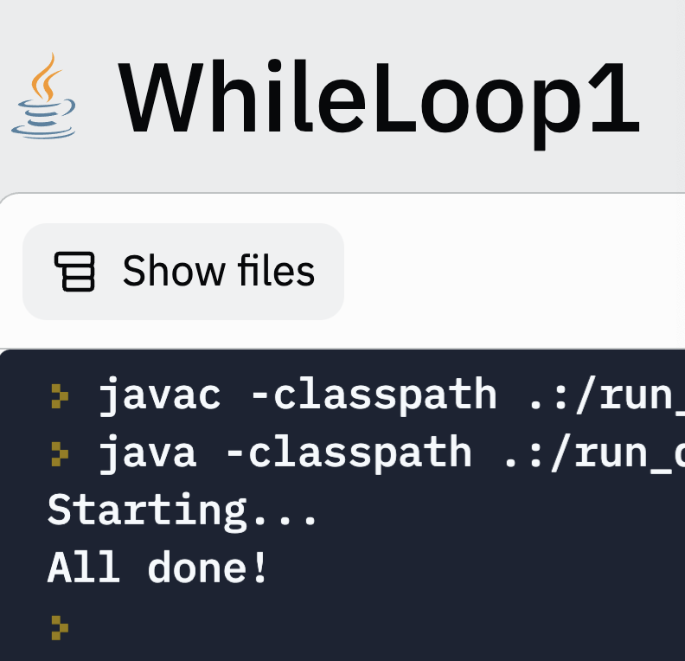
The Practical: Imperfect Abstractions Fail…
Sometimes, what looks like a bug at one level of abstraction cannot be understood without understanding what is happening at a lower level of abstraction.
Try it: https://replit.com/@braughtg/WhileLoop1
Notes:
If we think of int, abstractly as an actual integer we have a problem…
The behavior of this program makes no sense if an int were actually an integer.
- somehow repeatedly adding 1 to a positive value made it negative???
- how can that be????
We will see in a few weeks that:
- this is exactly the behavior that we should expect once we understand what an int is at a lower level of abstraction.
- the program is doing exactly what it should
- we just don’t understand what lies beneath the int abstraction.
- but once we do, this seemingly confusing program behavior will make perfect sense.
So sometimes…
- what looks like a bug at one level of abstraction
- is really a limitation of our abstraction
- that is, our abstraction is imperfect.
- so under some circumstances it does not behave as expected.
- we need to drill down and look at a lower level of abstraction to understand what is happening.
- For example with the TV remote
- If it is not pointed at the TV it does not work.
- To understand why, we need to think beyond the buttons and what they do.
- We need to know a little about a lower level of abstraction
- We need to realize that how it works is to transmit a signal (Infrared light) to the TV
- And that to do that, it must have a line of sight to the TV.
- Without thinking about that lower level of abstraction, we can’t understand why the remote has to be pointed at the TV.
- Admittedly this one is a little more intuitive than the int.
- But that’s just because we’ve lived with the limits of the TV remote abstraction without really pulling it apart before.
This is just one example of why learning the low level details that we’ll be looking at in this course may be helpful for you even if you only ever write code at a high level in something like Java.

Slide 17
What’s Next?
Read Syllabus (Questions on Wednesday)
Download Homework Activity 01 from course website
Complete it.
Convert to PDF.
Submit to Moodle by 9:30am Wednesday
🔑 – key ideas
🏆 – more challenging questions.

Slide 18

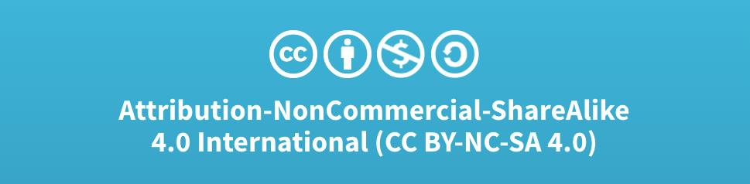
Acknowledgments
Slide Template From:
https://creativecommons.org/licenses/by/4.0/
Slide Content Licensed as:
Creative Commons Attribution-NonCommercial-ShareAlike 4.0 International License.
Notes:
Note: Individual images may be covered by their own licensing agreements and were incorporated here under fair use. Their use in this slide deck does not change or alter their licensing.

Slide 19
Why Computing Abstractions
Breadth of preparation for a wide range of possible futures.
Hardware, languages, operating systems, networks, web development
Understanding how things work builds intuition for:
Learning new abstractions
Creating new abstractions
Debugging across levels of abstraction
Sometimes, what looks like a bug at one level can only be understood by looking at a lower level of abstraction.
Notes:
Addressed on previous slide.

